Slide 1

SMARTREUSE
The AI Platform
for Circular
Manufacturing
We turn leftover inks, lacquers and coatings from hazardous waste into traceable industrial value.
AI • ERP • Reuse • ESG • Digital Product Passport
Investor Deck 2026
CoatDoctor

Slide 2
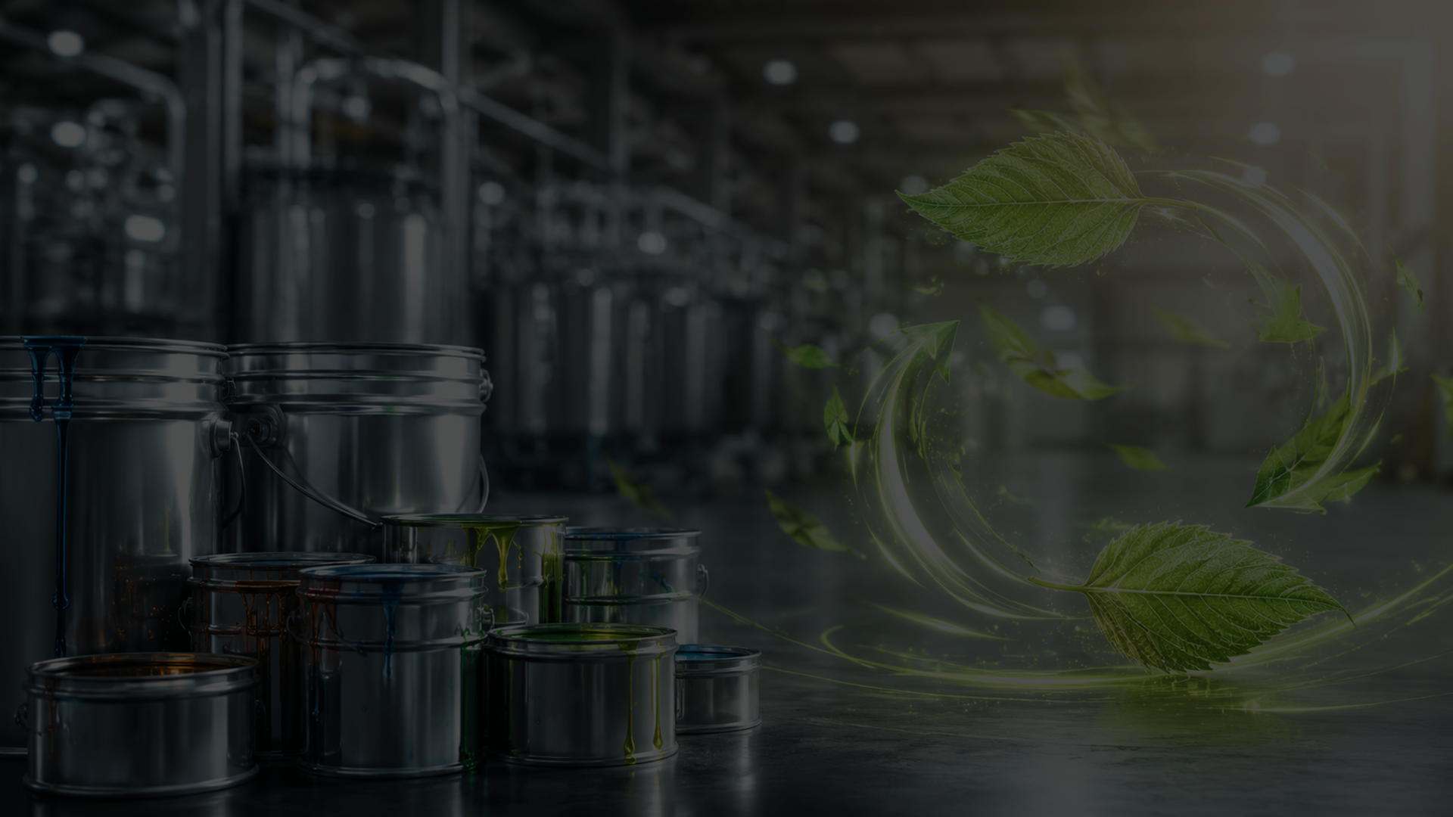
02
THE PROBLEM
Factories pay twice
for the same material.
€
€
CO₂
paid to buy
paid to dispose
created by waste
First, they buy premium chemical materials. Then, when production ends, valuable leftovers are classified, stored and disposed as hazardous waste.
The hidden cost is not only environmental. It is raw material, disposal, compliance work, warehouse time and lost operator efficiency.
Material value is destroyed exactly where it could be reused — inside the factory.
SMARTREUSE | CoatDoctor

Slide 3
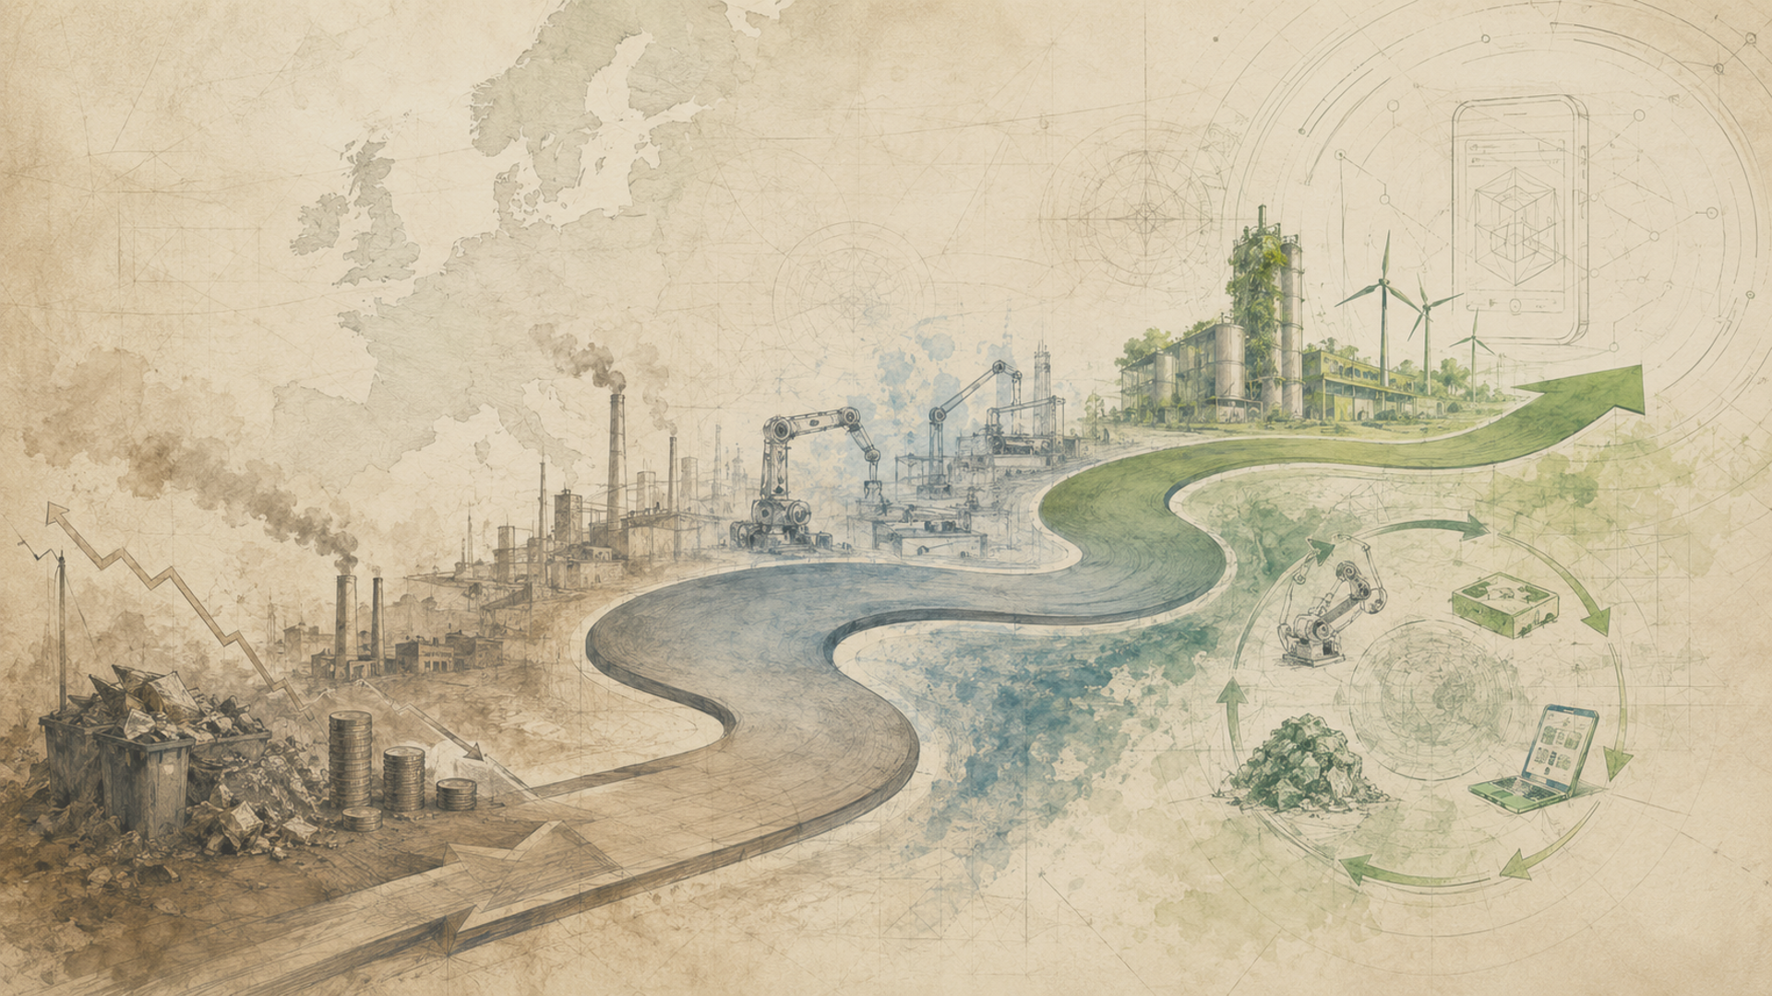
03
WHY NOW
Manufacturing is entering
a traceability decade.
ESG reporting, Digital Product Passport expectations, rising material prices and AI adoption are converging into one operational problem: factories need real data from the shop floor.
Cost pressure
ESG evidence
DPP readiness
AI adoption
Raw materials and disposal costs are rising.
Factories need auditable sustainability data.
Product data must become structured and traceable.
Industrial teams are ready for decision support.
SMARTREUSE sits at the intersection of cost reduction and compliance automation.
SMARTREUSE | CoatDoctor

Slide 4
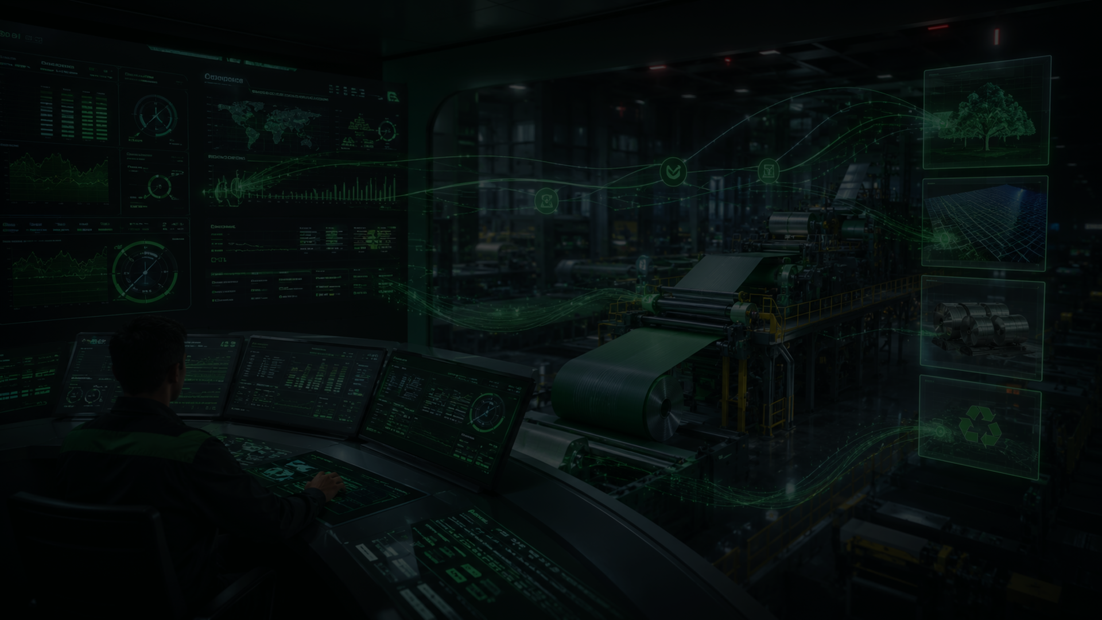
04
THE SOLUTION
AI that makes reuse
safe, measurable
and repeatable.
Recipe intelligence
The system understands component compatibility and target formulation rules.
Inventory optimization
SMARTREUSE connects production schedules, recipes, inventory and operator execution. It recommends the safest reuse strategy before the next batch is mixed.
Leftovers are converted into production-ready opportunities.
Execution tracking
Operators mix with a guided workflow and real-time traceability.
Not “less waste” as a slogan. Less waste as a production decision.
ESG / DPP data
Every reuse action becomes evidence, not manual paperwork.
SMARTREUSE | CoatDoctor

Slide 5
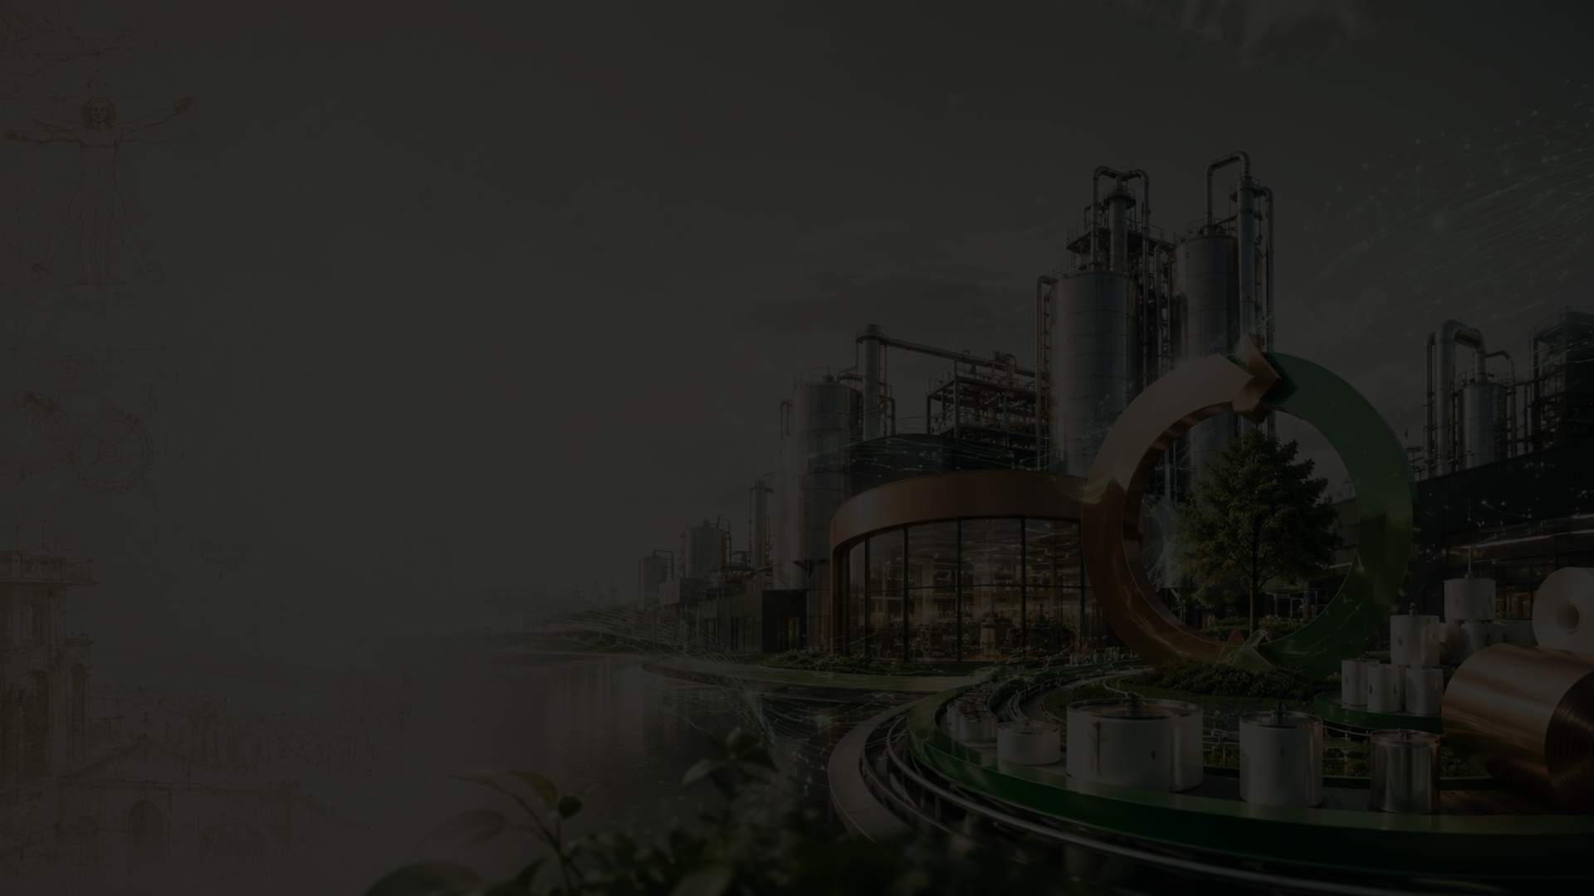
05
HOW IT WORKS
From ERP data
to circular execution.
SMARTREUSE is not a dashboard. It is a closed-loop manufacturing system: analyze, recommend, execute, prove.
1. Connect
2. Analyze
3. Optimize
4. Execute
5. Prove
ERP schedule, recipes, stock and material master data.
AI checks compatibility, limits, missing components and risk.
Best reuse path, alternatives and future reuse suggestions.
Operator mixing, scale guidance and batch traceability.
Automated ESG, audit and DPP-ready data.
ERP → AI Engine → Operator Portal → Traceability Layer
SMARTREUSE | CoatDoctor

Slide 6
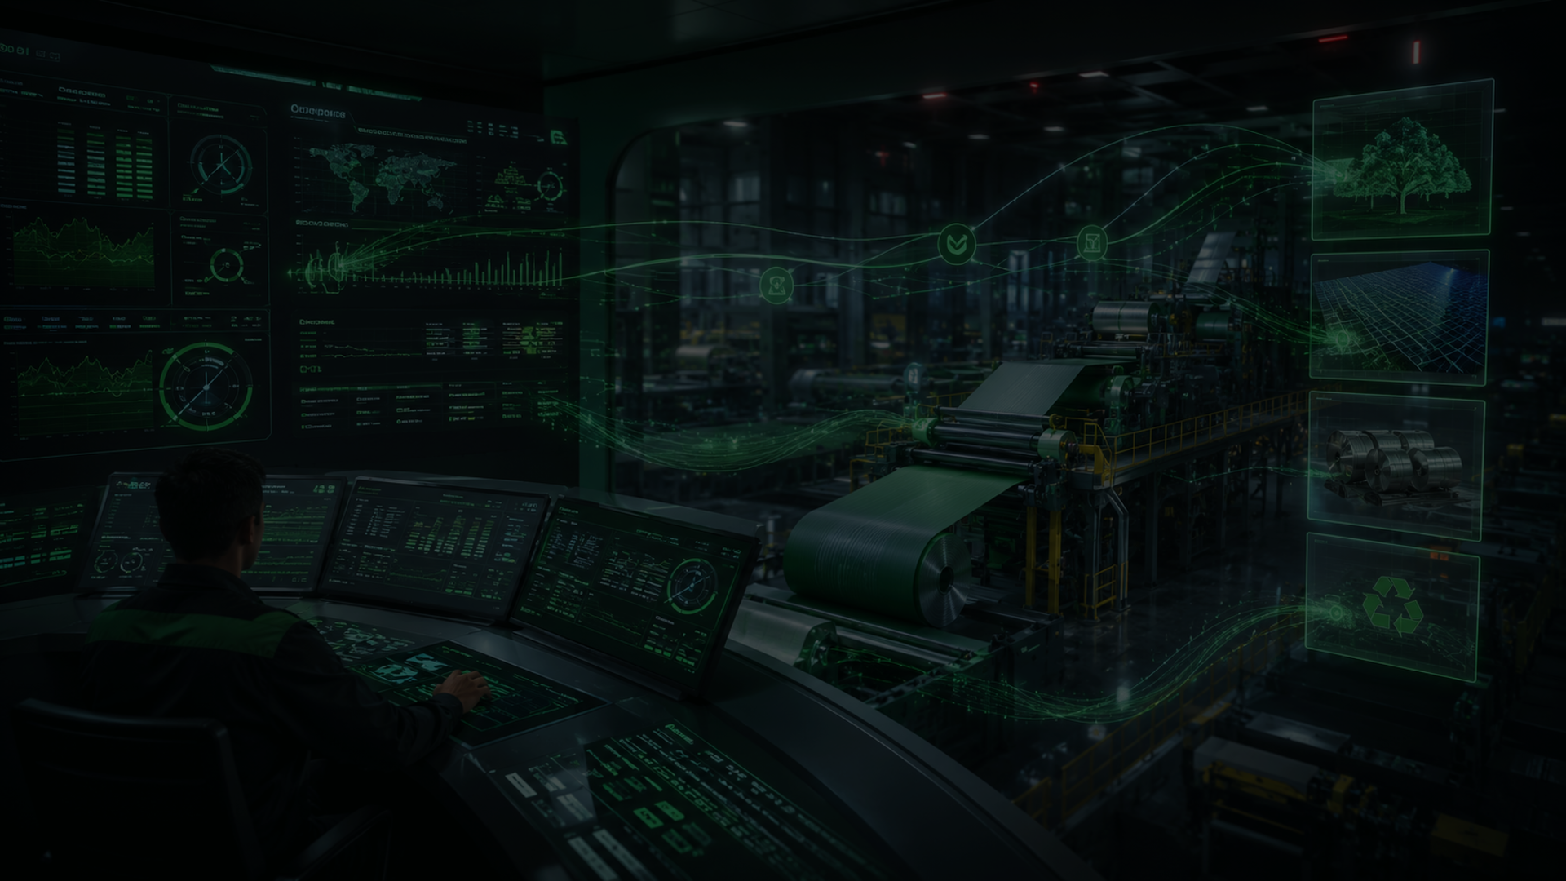
06
AI ENGINE
Our AI does what
spreadsheets cannot.
Decision Stack
✓
Recipe compatibility
It understands formulation logic, component restrictions, leftover aging, production timing and operator execution — then chooses the highest-value safe reuse option.
✓
Line-specific constraints
✓
Leftover consumption logic
✓
Alternative materials
✓
Production sequence
Result: reuse is no longer a manual “maybe”. It becomes a governed decision.
✓
Audit data generation
SMARTREUSE | CoatDoctor

Slide 7

07
CUSTOMER VALUE
The CFO and the ESG
manager finally want
the same thing.
SMARTREUSE connects financial savings with operational sustainability — without asking the factory to slow down.
27%
↓
100%
Live
material reuse observed in pilot scenario
raw material and disposal exposure
traceable reuse actions
operator efficiency and compliance evidence
Less waste. Lower costs. Better control. Cleaner data.
SMARTREUSE | CoatDoctor

Slide 8
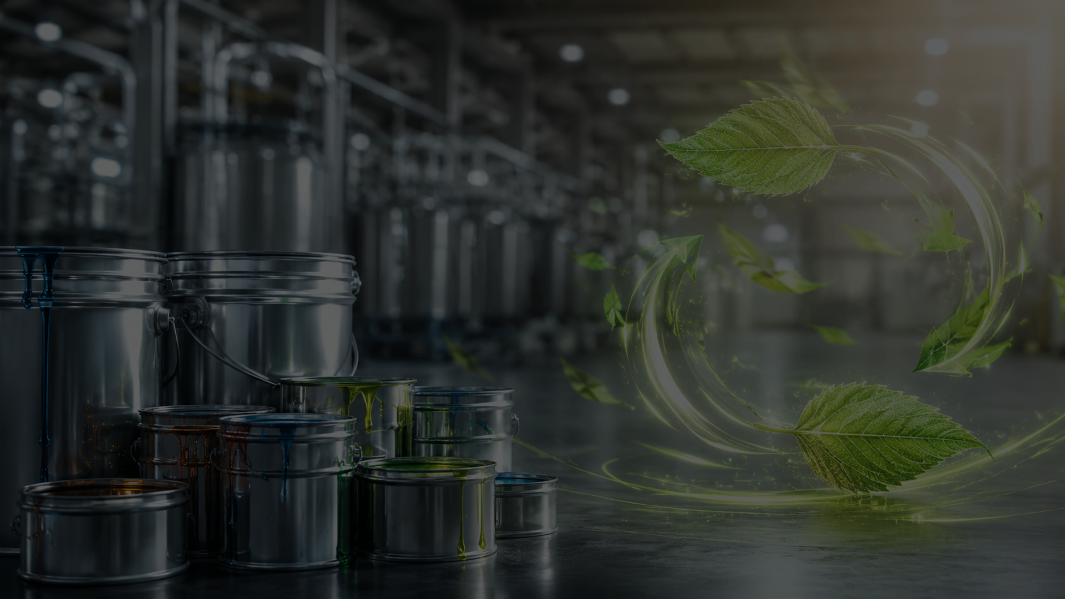
08
MARKET OPPORTUNITY
Start narrow.
Expand across industrial chemistry.
Initial beachhead: coatings, inks and metal packaging — where leftovers are expensive, production is recipe-driven, and traceability pressure is rising.
Beachhead
Expansion
Platform Vision
Coatings • Inks • Lacquers • Metal packaging
Adhesives • Composites • Specialty chemicals
Circular intelligence layer for manufacturing
Every factory with recurring recipes and expensive leftover materials is a potential SMARTREUSE customer.
SMARTREUSE | CoatDoctor

Slide 9

09
BUSINESS MODEL
Enterprise SaaS
with high-value
industrial modules.
Platform License
Core AI optimization, inventory logic, traceability and reporting.
Integration Fees
We sell the operational layer that turns waste reduction into a repeatable business process.
ERP, production schedules, material master and custom workflows.
AI Modules
Future Reuse, operator guidance, lab intelligence, compliance certificates.
Support & Pilots
Implementation, training, data validation and continuous improvement.
Land with savings. Expand with data. Retain through process integration.
SMARTREUSE | CoatDoctor

Slide 10

10
TRACTION
Built from inside
real production.
Working
ERP-ready
prototype with manufacturing data
schedule + inventory integrations
SMARTREUSE was not imagined in a slide deck. It was shaped around real industrial constraints: recipes, operators, leftovers, schedules and line-specific rules.
Pilot
D1
validated reuse logic
cloud database architecture
The next milestone is not invention. It is commercialization.
SMARTREUSE | CoatDoctor

Slide 11
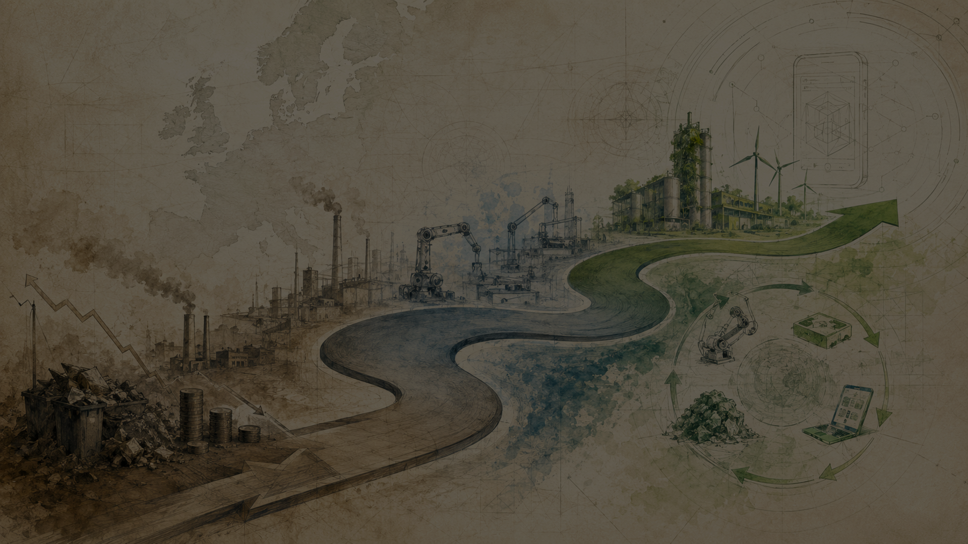
11
ROADMAP
A European circular
manufacturing platform.
We scale from controlled pilots into a vertical platform for chemical-material reuse and compliance data.
2026
2027
2028
2029
2030
1
2
3
4
5
Industrial pilots
Bulgaria scale-up
CEE expansion
Europe roll-out
Global platform
Our ambition: make safe reuse the default operating mode for factories using complex chemical materials.
SMARTREUSE | CoatDoctor

Slide 12
12
FUNDING ASK
We are raising
€250,000 to turn
validated technology
into a market launch.
Use of Funds
Product & AI
45%
Pilots
25%
Sales
15%
Capital will accelerate productization, paid pilots, sales execution, IP protection and operational readiness.
IP
10%
Operations
5%
Velislav Milkov | Founder & CEO
info@coatdoctor.com | +359 895 092 006
coatdoctor.com
Join us in eliminating industrial waste at the source.
SMARTREUSE | CoatDoctor

